Slide 1
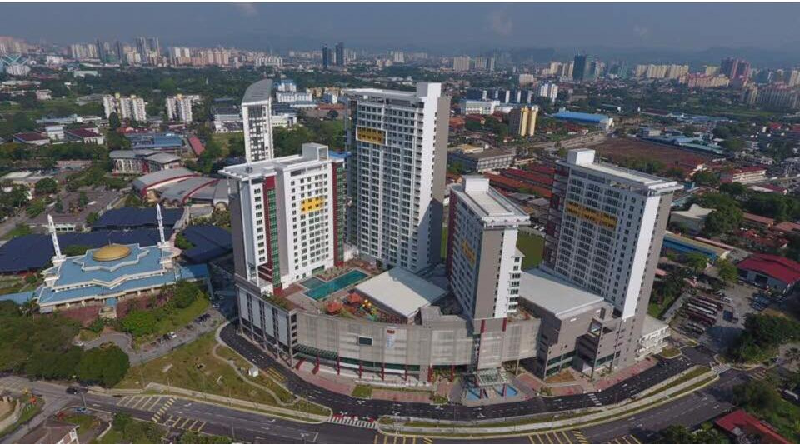
UTM in Brief
Prof Nordin Yahaya
Pro-Vice-Chancellor (International)
Universiti Teknologi Malaysia (UTM)
25 May 2017

Slide 2
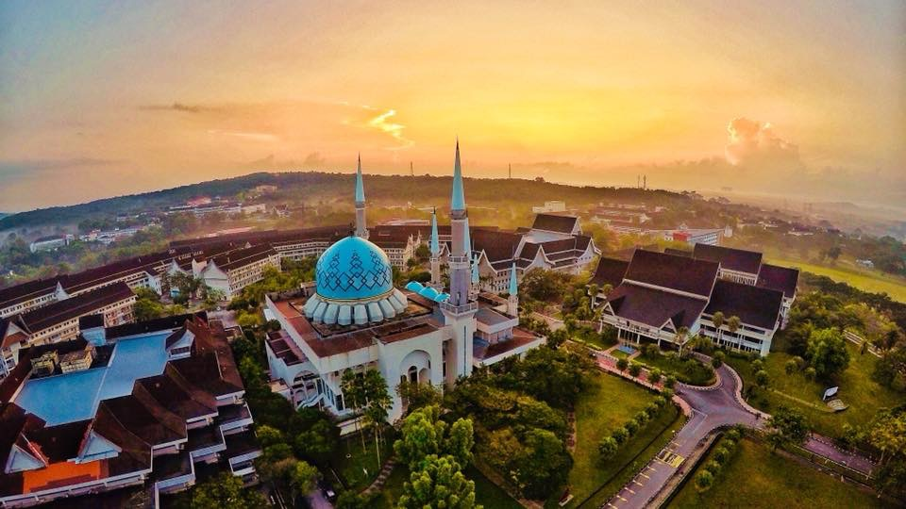
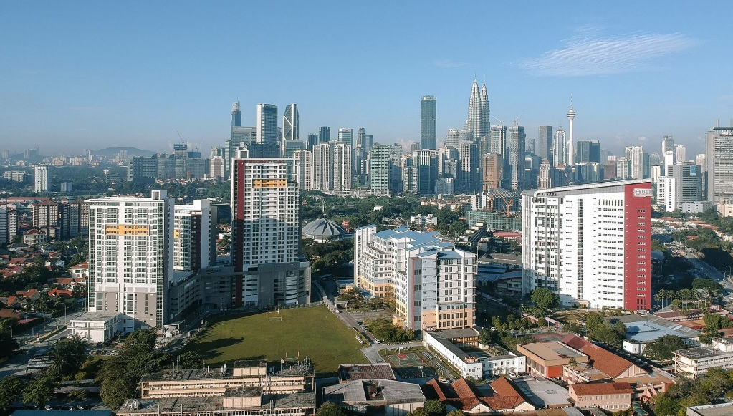
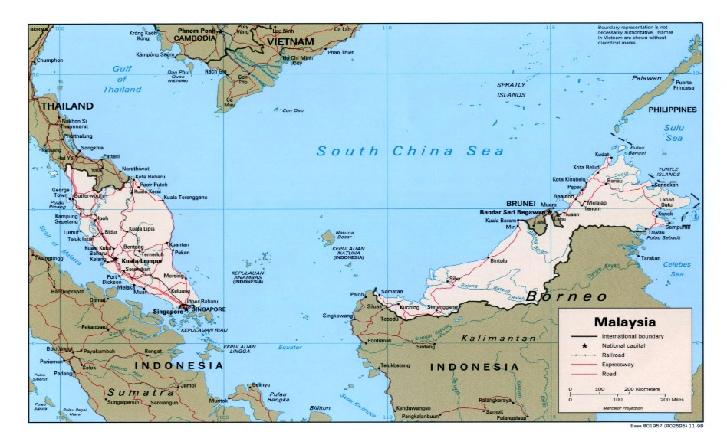
Universiti Teknologi Malaysia (UTM) – In Brief
UTM Johor Bahru
UTM Kuala Lumpur
23203 Students*
12391 graduate students
5351 PhD students (43%)
3086 international students
2624 academic & research staff
19,764 indexed publication (2011-2017)#
65,898 citations (2013-2017)
823 Outbound mobility (2017)
757 Inbound mobility (2017
705 PhD awarded (2017); 3312 (Total)
*Dec 2017 (Headcount); #Scopus

Slide 3
Academic Faculties & Schools
7
faculties
200
Postgraduate prgms programmes
55
Bachelor prgms

Slide 4
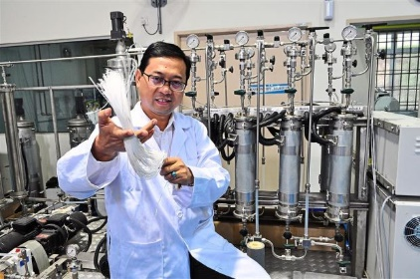
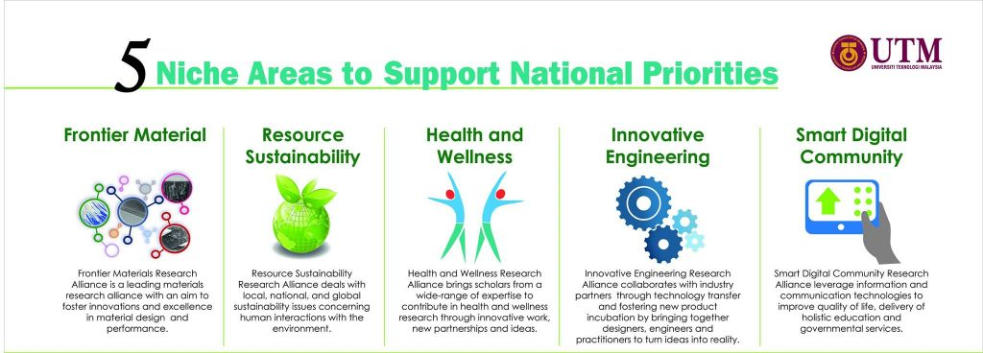
Research Alliance
4 Higher Institution Centre of Excellence (HiCOE)
Wireless Communication Centre (WCC)
Advanced Membrane Technology Centre (AMTEC)
Institute of Noise and Vibration (INV)
Institute of Bio-product Development (IBD)
6 RESEARCH INSTITUTES
Research Institute for Sustainable Environment (RISE)
Institute of Future Energy (IFE)
Institute of Human Centered Engineering (IHCE)
Institute for Smart Infrastructures and Innovative Construction (ISIIC)
Institute for Vehicle Systems and Engineering (IVeSE)
Ibnu Sina Institute for Scientific and Industrial Research (IBNU SINA ISIR)

Slide 5
UTM Global Rankings 2018
#18
QS Ranking | Subjects
Top 100 | Built Environment/Architecture Chemical Engineering; Electrical & Electronics Engineering; Mechanical Engineering Civil & Structural Engineering
Top 150 | Computer Sciences & Information System Environmental Sciences;
Top 200 | Material Sciences; Education Agriculture & Forestry
Top 250 | Chemistry Mathematics
Top 350 | Physics & Astronomy
Top 450 | Biological Sciences
#50
Top 100
Engineering
#53
Engineering & Technology
#228
#271
14 subjects ranked
#49
#101
#66

Slide 6
Subject Rankings 2018
Ranking | Subjects Ranked in 2017
University Ranking by Academic Performance (URAP By Field) - Engineering (120) | Environmental Engineering (38) Chemical Eng (68) Mechanical Engineering (75) Civil Engineering (84) Material Engineering (111) Electrical & Electronics Engineering (160) Information & Computing Science (296)
US World News Best Global University | Engineering (50) Material Science (233), Chemistry (299) Computer Science (198)
Shanghai Ranking's Global Ranking of Academic Subjects | Chemical Eng (51-75), Water Resources (51-75) Instruments Science & Technology (101-150), Mechanical Eng (151-200), Computer Sc & Eng (301-400), Energy Sc & Eng (301-400), Environmental Sc & Eng (301-400),
Taiwan Ranking by subjects | Chemical Eng (48) Civil Eng (145),
Top 50
Top 50
Top 50

Slide 7
2014 2015 2016 2017 2018
#53
2018
203
#90
#100
2017
#134
2016
Engineering and
Technology
#122
#256
2015
#204
2018
2014
#211
2017
2013
363
#283
2016
Social Sciences and Management
#272
#363
2015
2018
2014
#296
#372
2017
Arts and Humanities
2016
2014
400+
#311
#378
2018
Natural Sciences
2017

Slide 8
Top 30 Universities in Engineering & Technology in the UK (QS-WUR By Faculty 2017)
UK | Universities
1 | University of Cambridge
2 | Imperial College London
3 | University of Oxford
4 | The University of Manchester
5 | UCL (University College London)
6 | The University of Edinburgh
7 | University of Southampton
8 | University of Birmingham
9 | University of Bristol
10 | The University of Sheffield
11 | University of Leeds
12 | The University of Nottingham
13 | King’s College London
14 | The University of Warwick
W
3
6
8
53
58
73
106
116
119
121
124
133
135
137
UK | Universities
W
150
152
184
189
198
200
206
215
216
216
223
244
264
279
293
301
15 | University of Glasgow
16 | University of Bath
17 | Newcastle University
18 | Loughborough University
19 | University of Strathclyde
20 | Queen Mary University of London
21 | Cranfield University
22 | University of Surrey
23 | Cardiff University
24 | Durham University
25 | University of Liverpool
26 | Queen’s University Belfast
27 | Heriot-Watt University
28 | Lancaster University
29 | University of Exeter
30 | University of St Andrews
#53 UTM

Slide 10
UTM Global Rankings 2011-2017
2015
100
#253
2017
#288
2016
#303
2015
#355
2013
Up 167 places since 2011
#420
2011

Slide 11
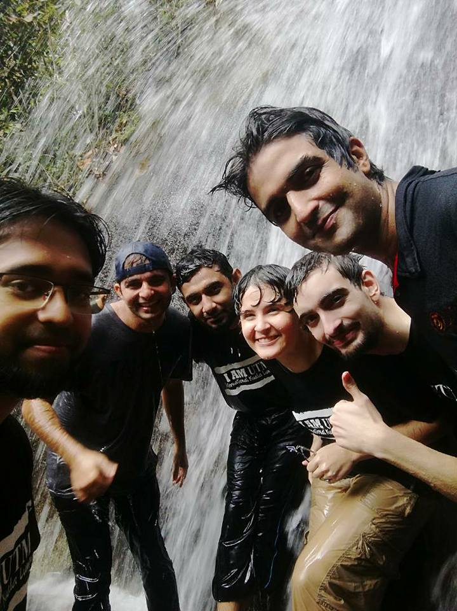
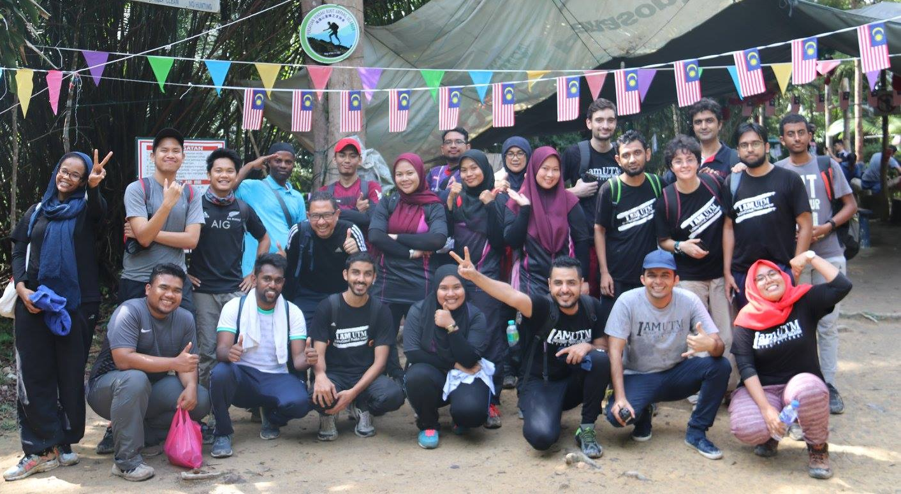
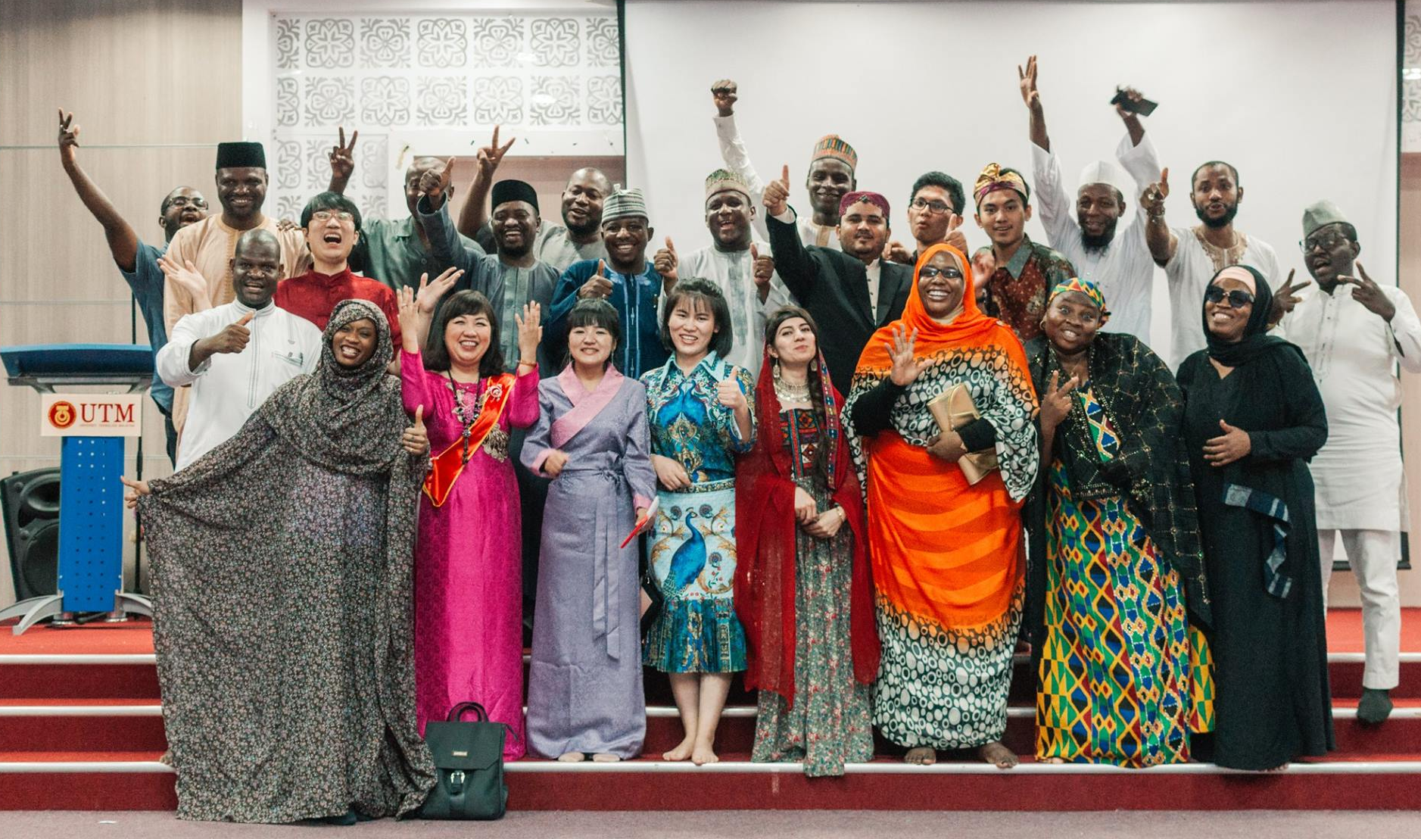
Internationalisation@ UTM
Internationalisation@UTM

Slide 12
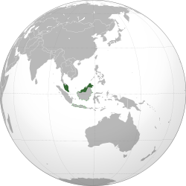
300 Academic & Research Global Partnerships

Slide 13
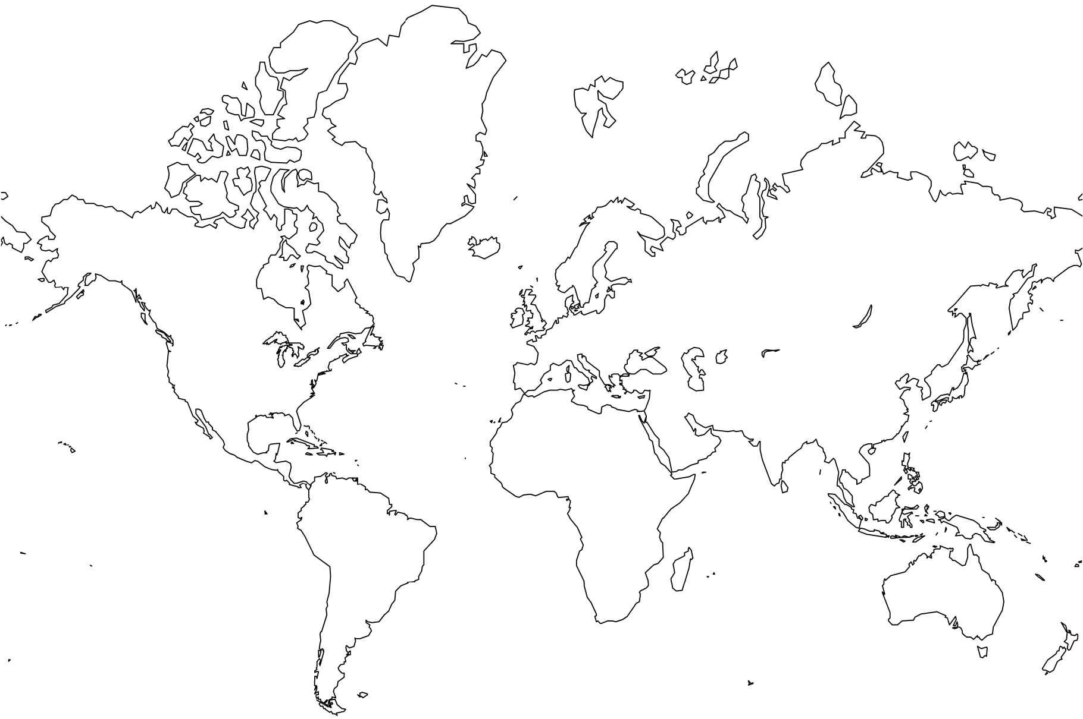
Global Alliances in Niche Area (multi-lateral partnerships)
ATU-Net
ALN

Slide 14
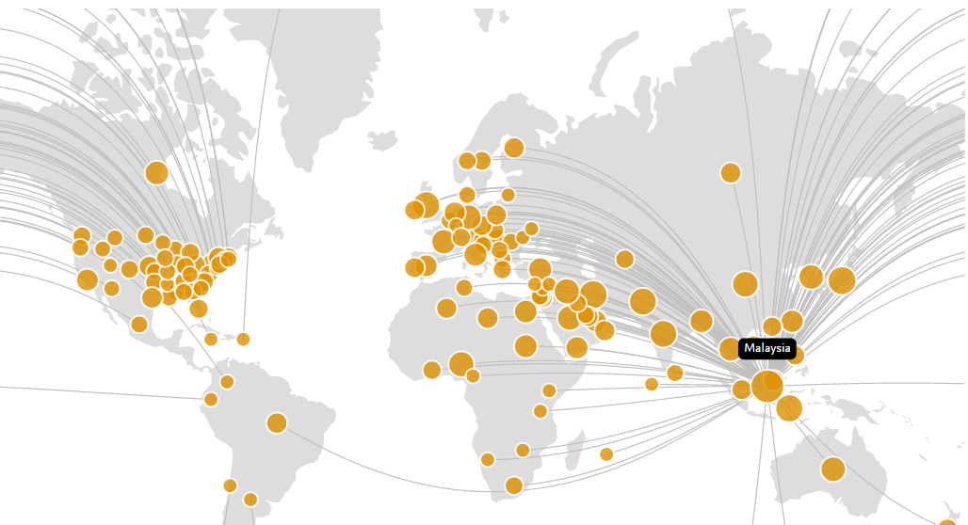
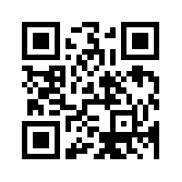
Overall UTM Collaboration Map Worldwide* (2012 – 2016)
Universities | Co-Authors
KMITL (Thailand) | 65
Nagoya Institute of Technology (Japan) | 49
Imperial College London | 62
Delft (Holland) | 17
Monash (Australia) | 34
Islamic Azad University (Iran) | 385
Abubakar Tafawa Balewa University, | 63
King Saud (Saudi Arabia) | 145
Sebelas Maret (Indonesia) | 58
Inha (Korea) | 19
COMSATS (Pakistan) | 99
Uni of Ottawa (Canada) | 108
Nat Inst of Tech Karnataka (India) | 29
Uni of Tech Baghdad (Iraq) | 32
Penn State (USA) | 18
Universidad de Salamanca (Spain) | 14
Universite de Rennes 1(France) | 7
RWTH Aachen University (Germany) | 12
Politechnico di Milano (Italy) | 12
Vilnius Gediminas TU (Lithuania) | 25
NTU (Singapore) | 36
De La Salle University (The Philippines) | 10
Ton Duc Thang University | 19
UTB (Brunei) | 18
Zaman University (Cambodia) | 8
Source: Pure, Scopus & Elsevier Fingerprint Engine™ © 2018 Elsevier B.V.
www.apaie2018.or

Slide 15
UTM-UK Universities Joint-Publication
Universities | # of shared output*
Imperial College London | 61
University of Southampton | 43
University of Liverpool | 33
University of Surrey | 30
University of Birmingham | 29
University of Nottingham | 23
University of Cambridge | 20
Heriot-Watt University | 19
University of Sheffield | 18
Loughborough University | 17
University of Manchester | 14
Newcastle University | 14
Glasgow Caledonian University | 13
University of Dundee | 12
University College London | 11
Universities | # of shared output*
University of Exeter | 11
University of Oxford | 11
Liverpool John Moores University | 11
University of Bristol | 10
Brunel University London | 10
University of Kent | 8
University of Glasgow | 7
Oxford-Brookes University | 7
University of Leicester | 7
Queen Mary University London | 6
University of Leeds | 6
Cardiff University | 6
University of Warwick | 5
University of Strathclyde | 5
University of Swansea | 5
*indexed by Scopus 2011-2016

Slide 16
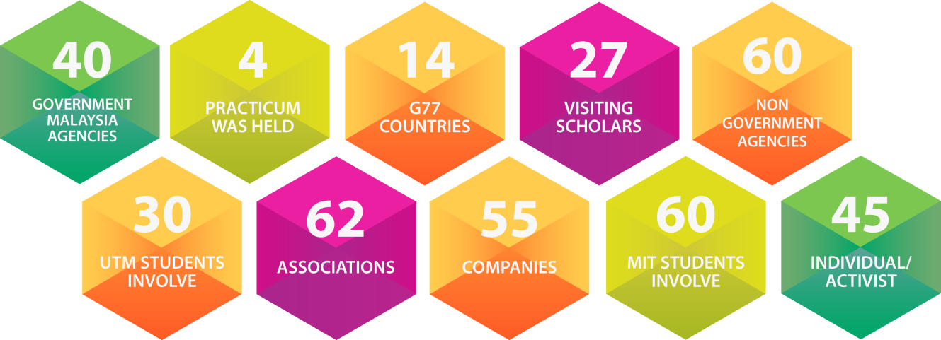
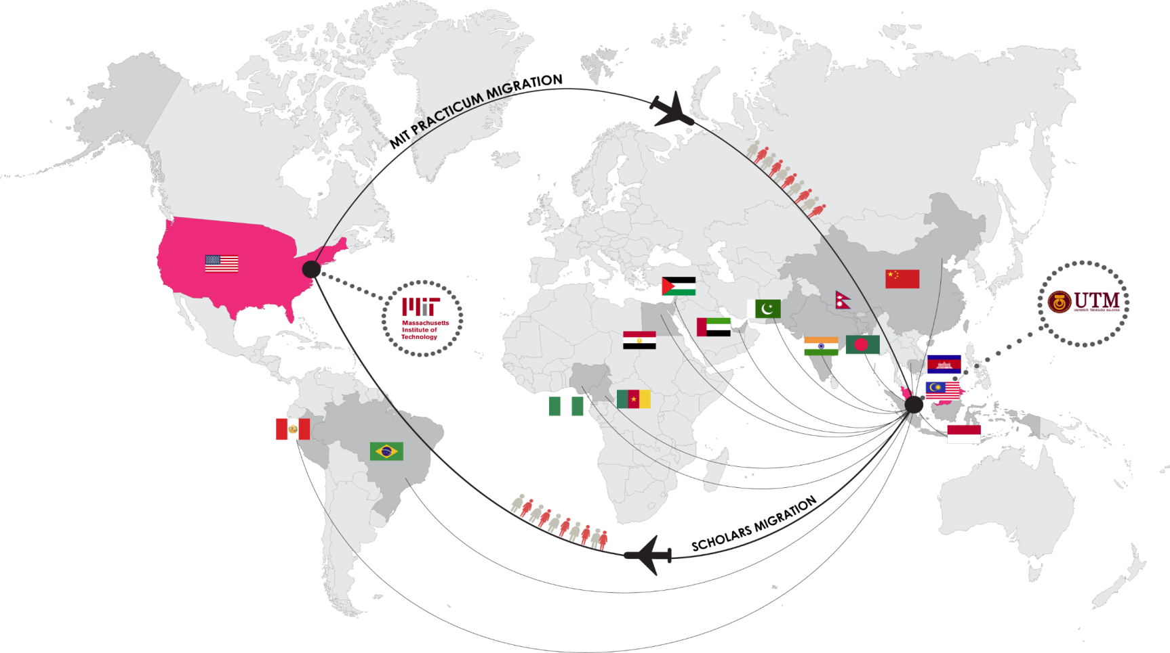
MIT-UTM Malaysia Sustainable Cities Program (MSCP)
MSCP research examines Malaysia’s city planning and development that reflect a commitment to the principles of sustainability
Focal areas:
Economic and ecological sustainability
Natural resource management
Environmental quality improvement
Socio-cultural impacts of development
http://malaysiacities.mit.edu/

Slide 17
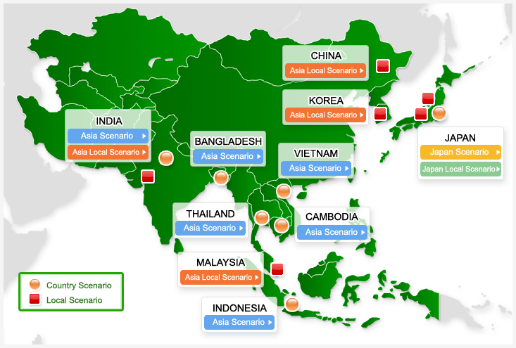
LOW CARBON SOCIETY ASIAN NETWORK
RESEARCH TEAM: Universiti Teknologi Malaysia (UTM), Kyoto University (KU), Okayama University (OU), National Institute for Environmental Studies (NIES)
SPONSOR: Japan International Cooperation Agency (JICA) , Japan Science and Technology (JST)
HOST: UTM
AIM: Development of methodology for Low Carbon Society (LCS) scenarios in city and local context
(Source: National Institute of Environment Studies, Japan)

Slide 18
Research & Development in Sustainable transportation
UTM Centre for Low Carbon Transport Research in Cooperation with Imperial College London
Malaysia-Thailand Joint Authority (MTJA) Research Collaboration Project (UTM-ICL-KMUTT-Burapha University)
Other UTM-ICL Joint Research Areas:
Chemical Engineering
Non-Destructive Evaluation
Photonics
Water Resources & Management
UTM-ICL Joint Publication/Patents
More than 80 indexed joint-publications
3 International patents

Slide 19
Global Strategic Partnership: Imperial College London
UTM Centre for Low Carbon Transport Research in Cooperation with Imperial College London
Malaysia-Thailand Joint Authority (MTJA) Research Collaboration Project (UTM-ICL-KMUTT-Burapha University)
Other UTM-ICL Joint Research Areas:
Chemical Engineering
Non-Destructive Evaluation
Photonics
Water Resources & Management
UTM-ICL Joint Publication/Patents
More than 70 indexed joint-publications
3 International patents
Academic Activities
More than 20 Academic Staff obtained PhD from ICL
Research attachment by young UTM academics at ICL
Visiting professors program
Honorary Doctorate for ICL President Alice Gast

Slide 20
Global Strategic Partnership: University of OXFORD
Oxford Centre for Industrial and Applied Mathematics (OCIAM)
&
UTM Centre for Industrial and Applied Mathematics (CIAM)
Established: 12.12.12
Other Collaborators

Slide 21
UTM – Collaboration with UK Universities
Heriot-Watt University, Dearman Engine Company (UK) and Green Data Centre LLP in
“Next Generation Green Data Centres for Environmental and Business Sustainability” worth MYR12.9M (GBP2.3M)
University of York & University of Leeds in Southeast Asia Small Scale Research Partnerships-Newton-Ungku Omar Fund (UK-SEA-NUOF) 2016,:
“Sustainable Production of Compost, Biofuels and Chemicals from Oil Palm Residues”. – worth MYR453,700 (GBP80,000)
Loughborough University in:
“Printed solar modules for large area roof applications”
University of Northumbria in:
Development of the Incremental SI(Structure and Infill) Housing for Low-income Population in Malaysia
Future Cities Catapult Limited (UK) in:
“Building local capacity in understanding, analyzing and visualizing big data in Malaysian cities in Malacca”

Slide 22
Horizon 2020 - Marie Skłodowska-Curie Actions (MSCA) Project
UTM-Wireless Communication Centre (WCC) Collaboration under Horizon2020-MSCA-RISE.
“Advancing the State of the Art of Multiple-Input Multiple-Output (MIMO): the key to the successful evolution of wireless networks".
Worth €904,500 (MYR4.1M)
Activities:
Joint- Research
Exchange of Academic/Researchers
Joint-publication
Joint-workshop/seminar

Slide 23
Engineering Network among 40 top-Universities in ASEAN and Japan
http://www.seed-net.org/
10 ASEAN countries
26 Member Institutions
Japan
14 Supporting Universities
Hokkaido University
Keio University
Kyoto University
Kyushu University
National Graduate Institute for Policy Studies
Shibaura Institute of Technology
Tokai University
Tokyo Institute of Technology
Toyohashi University of Technology
The University of Tokyo
Waseda University
Tohoku University
Nagoya University
Osaka University
・University of Yangon
・Yangon Technological University
・National University of Laos
・Institute of Technology of Cambodia
・Hanoi University of Science and Technology
・Ho Chi Minh City University of Technology
・Chulalongkorn University
・King Mongkut’s Institute of
Technology Ladkrabang
・Burapha University
・Kasetsart University
・Thammasat University
・University of the Philippines - Diliman
・ De La Salle University
・Mindanao State University – Iligan Institute of Technology
・Universiti Malaya
・Universiti Sains Malaysia
・Universiti Putra Malaysia
・Universiti Teknologi Malaysia
・National University of Singapore
・Nanyang Technological University
・Universiti Brunei Darussalam
・Institut Teknologi Brunei
・Institut Teknologi Bandung
・Universitas Gadjah Mada
・ Universitas Indonesia
・ Institut Teknologi Sepuluh Nopember

Slide 24
Strategic collaboration with Top Global Universities*
#40
#55
#67
#72
#77
#79
#96
#93
#100
#1
#5
#6
#8
#12
#17
#23
#35
#36
*QS-WUR 2019

Slide 25
UTM University Presidents Forum (UPF)
UPF 2017 Highlights
55 universities
100 external participants
18 countries
30 Presidents/VC/Rectors
11 MoU/MoA signed
Ranking Workshop

Slide 26
UTM Study Abroad Fair
List of exhibitors 2017 :- 1. Deakin University, Australia 2. INNES Institute Vienna, Austria 3. Polytechnique de Montréal, Canada 4. University of Electronic Science and Technology of China, China 5. Helsinki Metropolia University of Applied Sciences, Finland 6. ISAE-ENSMA, France 7. Mines Albi – Institut Mines Télécom, France 8. Pforzheim University, Germany 9. Amity University, India 10. Universitas Kristen Maranatha, Indonesia 11. Universitas Muhammadiyah Yogyakarta, Indonesia 12. Shibaura Institute of Technology, Japan 13. Tohoku University, Japan 14. University of Tsukuba, Japan 15. Yamaguchi University, Japan 16. Far Eastern University, Philippines 17. Kumoh National Institute of Technology, South Korea 18. Woosong University, South Korea 19. ESADE Business School, Spain 20. Universidad Católica San Antonio de Murcia, Spain 21. University of Vigo, Spain 22. Mahasarakham University, Thailand 23. Nottingham Trent University, UK 24. University College London, UK 25. University of Kent, UK 26. University of Sheffield, UK

Slide 27
Global Education: UTM (2017)
Top Countries/Regions 2017
UTM Top 15 International Students (fulltime) | Number (Total 3086)
Indonesia | 398
Nigeria | 311
Iran | 307
Pakistan | 241
Iraq | 182
Yemen | 179
Bangladesh | 146
Saudi Arabia | 142
Egypt | 105
Sudan | 105
India | 69
China | 47
Libya | 42
Singapore | 32
Palestine | 31
Outbound Mobility
Inbound Mobility
Japan | 369
Indonesia | 138
Thailand | 55
South Korea | 49
Australia | 27
China | 23
Germany | 22
Singapore | 15
Taiwan, China | 15
Brunei Darussalam | 14
United Kingdom | 12
France | 11
Italy | 10
Spain | 9
Austria | 7
The Philippines | 3
Indonesia | 709
Japan | 195
Thailand | 139
China | 56
South Korea | 51
Saudi Arabia | 45
Vietnam | 44
The Philippines | 43
France | 29
The Maldives | 27
Brunei Darussalam | 22
Colombia | 21
India | 10
Taiwan, China | 7
Spain | 6
Germany | 5
3086 international students
823 Outbound mobility (2017)
757 Inbound mobility (2017)

Slide 28
Residensi@UTMKL

Slide 29
UTM GREEN & SUSTAINABLE CAMPUS
THANK YOU
www.utm.my/international

